Slide 1

Group 1 : Nerdy_Boy
Title : Tic ― Tac ― Toe ( Vector Edition )
Members : RAI SURAJ ( ID : 20244098 )
Course : Object – Oriented Programming ( C++)
Professor : Carol Sonia
Nerdy Boy : Dexter

Slide 2
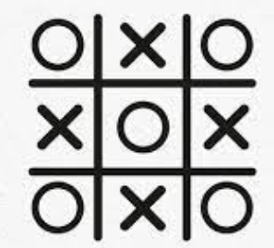
Question :
Who, is the winner here and why ?
Ans:
Player ( O ) forms two St lines in the grid.
Meaning, any St lines will decide the winner.
Fig : Tic – Tac – Toe ( Grid )

Slide 3
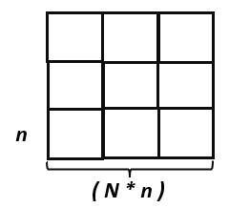
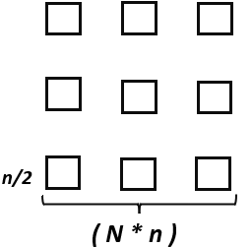
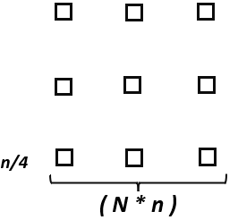
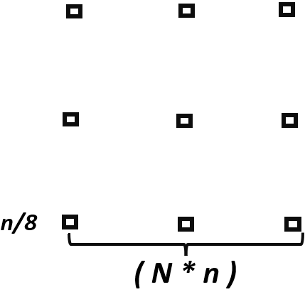
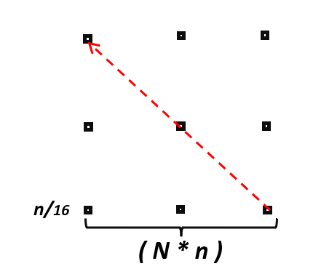
Visualizing, Square Grid Block into Points .
Take a square block of length n. Then,
Place the N, no of square forming a Square of N *n.
Keeping the Grid Size Same, but decreases the size of Sq blocks by Half ½ , ¼ , 1/8, 1/16 and so on.
1st round
2nd round
3rd round
4th round
Here,
After 4th round, the blocks had became sufficiently small ( 1/16th) to consider them as Points in the Graph.
And, able to pass the Vector through it..

Slide 4
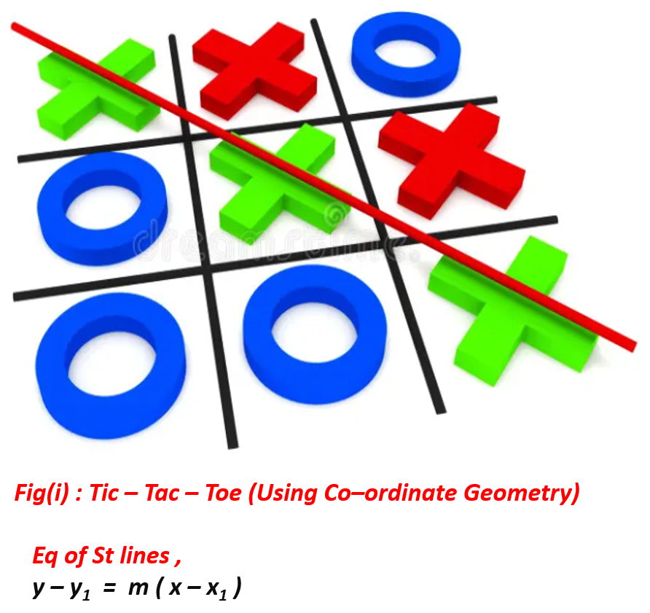
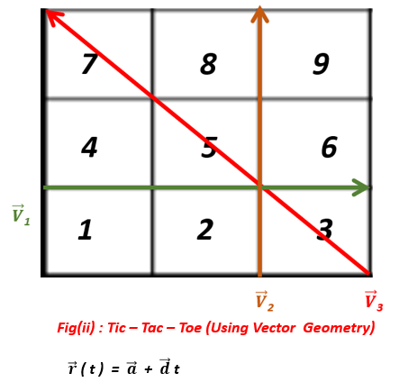
Project Visualization :
1) Lines or Vectors Movement in the Grid :
There are two basic topic in math, when it comes to Graph, Points and the St lines.

Slide 5
Tic_Tac_Toe : Vector Edition
“ Why just learn things , Use it.. ”
Introduction :
• A mathematically re-defined tic-tac-toe game designed for any desirable size.
• Use Vector , Co-ordinate Geometry Eqs (like Paramatrics , Dot Product ) to decide the winner normally.
• Playing Mode : Normal or Tie – Breaker (One player will be mathematically declare as the winner) .
Objectives :
• Demonstrates Real – life applications of Vector , Co – ordinate Geometry through Interactive Game .
• Visually and Fun Way of Learning of the Academical Topics like Vectors, Co – ordinate Geometry .
• To blend both Mathematical Concepts and Programming languages Logics togetherly.
• Develop Tic – tac – toe Gaming for any Scalable board size of ( N * N ) square Grids .

Slide 6
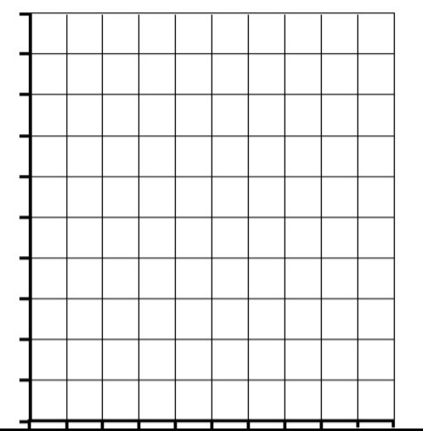










Vectors Movement in the Grid :
Visualization of Vector :
Whenever a player wins the game,
his winning moves will always forms a St line.
Now, whenever we see the Visualize the St line,
then one can use Cartesian or Vector Geometry.
$\vec{V}$₁₀
$\vec{V}$₉
$\vec{V}$₄
13
14
15
16
$\vec{V}$₃
9
10
11
12
Total no of Vectors = Rows + Column + Diagonals
= N + N + 2
჻ Vectors (Total) = 2 ( N + 1 )
When ,
N = 4
Total Vectors = 2 ( 4 + 1 )
჻ Vectors (Total ) = 10
$\vec{V}$₂
5
6
7
8
$\vec{V}$₁
1
2
3
4
$\vec{V}$₅
$\vec{V}$₆
$\vec{V}$₇
$\vec{V}$₈
Fig : 4 * 4 matrix

Slide 7
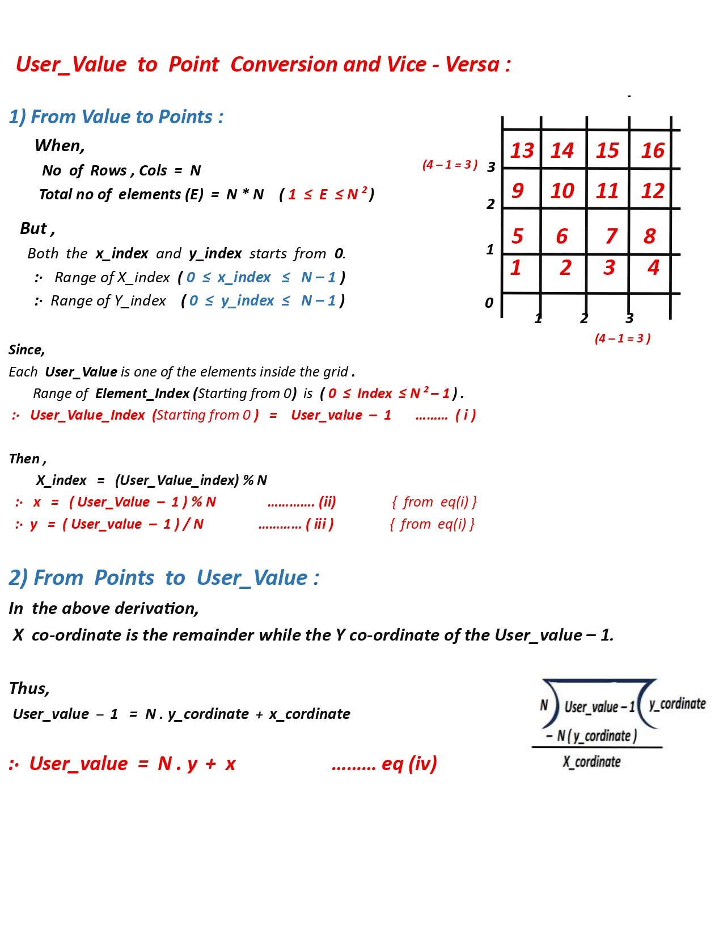
Numeric Value into Points :
We need to remember that the user ,
will always input numeric value (displayed in the Console)
which will be used as cell.
So, that numeric value will be converted into points (Coordinates)
of the graph using few math formula.

Slide 8
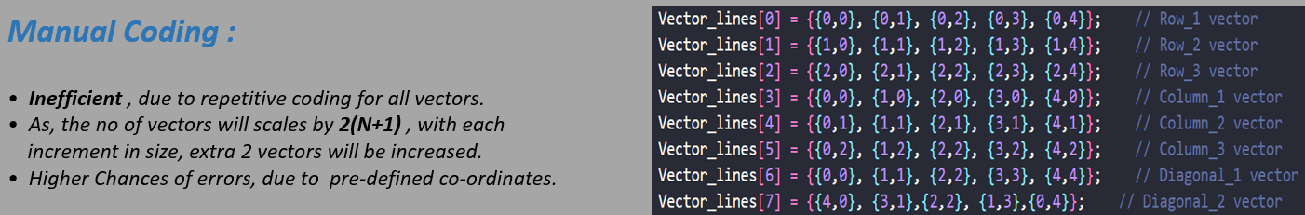
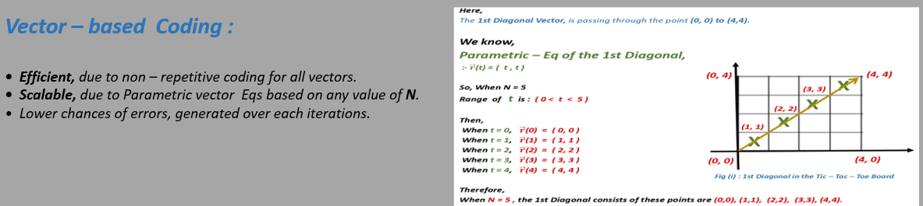
Why use Vector Geometry ??

Slide 9
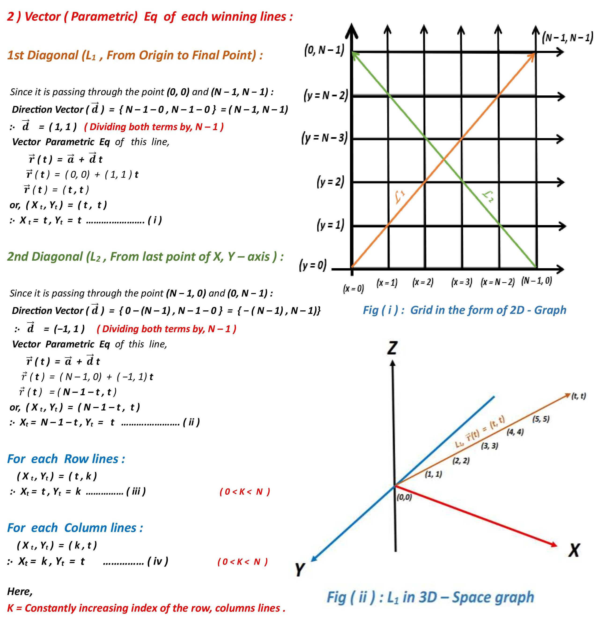
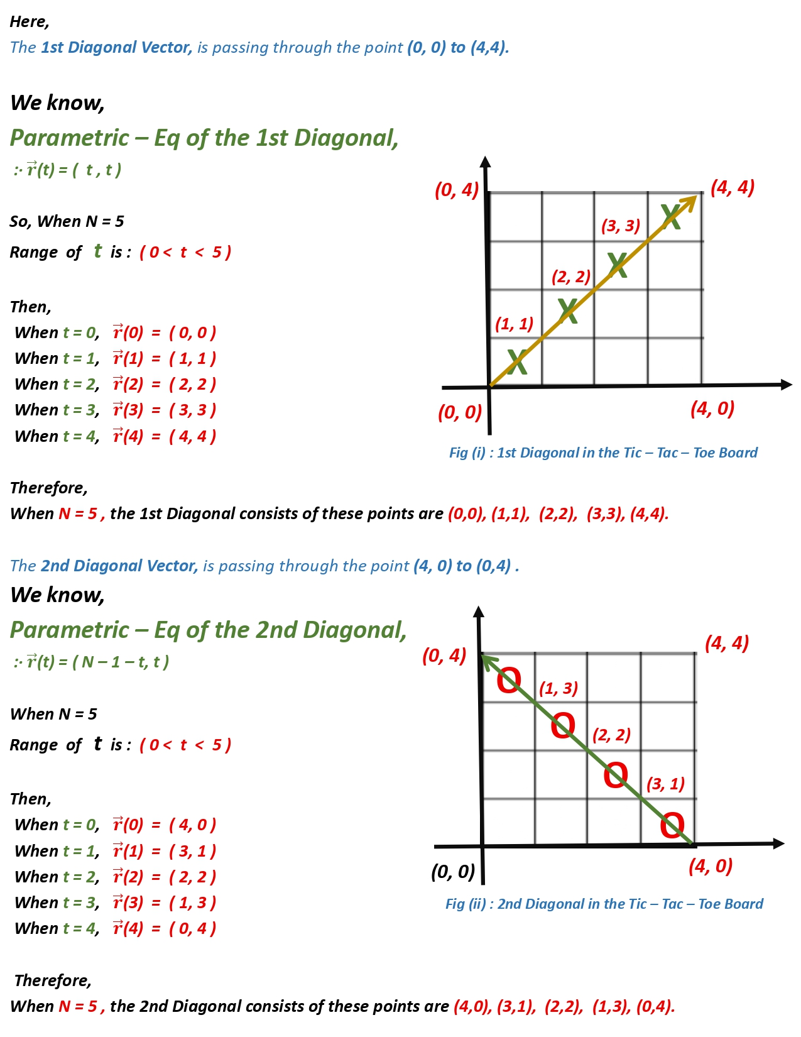
Vector Parametric Eqs of all lines :

Slide 10
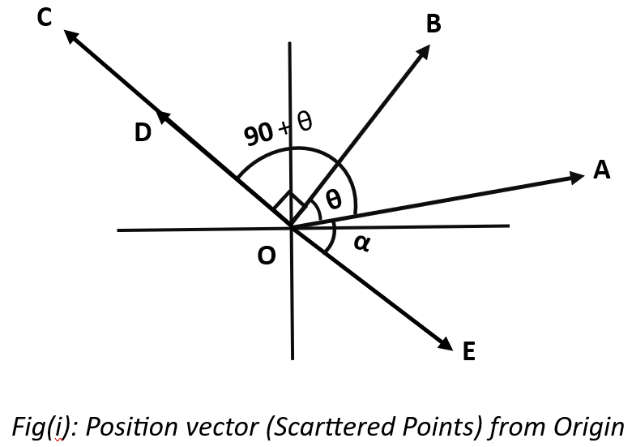
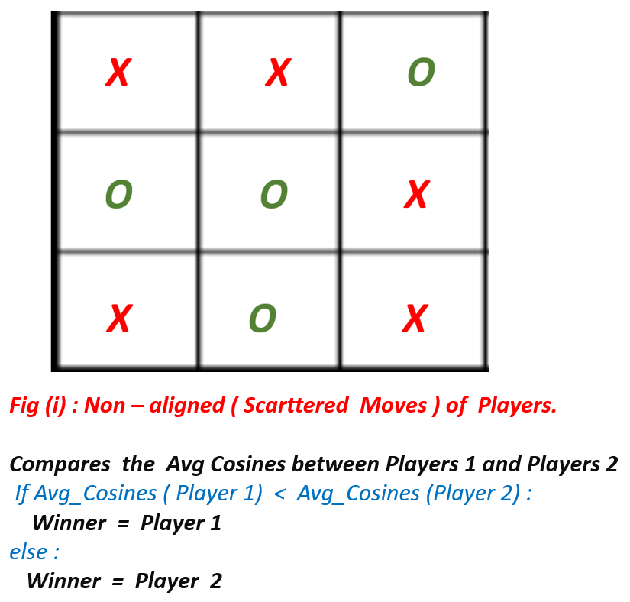
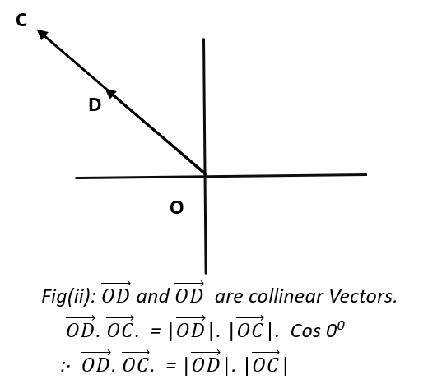
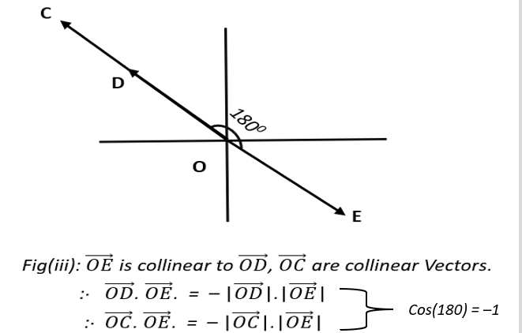
Tie – Breaker Mode :
Y
X
In this mode, the player moves are plotted in the Graph
as different points ( A,B,C,D,E ) as shown in the Upper Figure.
1st Step :
We will plot those respective player moves in Graph (as Shown in Fig).
2nd Step :
We will Calculate the Centroid (Middle Point) among all the points to evaluate how separate (Intersection Angle)
each vectors are from each others . Like , In Figure between (OA, OB) = θ, (OA and 0C,OD) = 90 + θ.
3rd Step :
We will make all the possible vector pair sets and then calculate the Angle of intersection (Cosθ) between them.
4th Step : We will calculate the average angle of intersection for each players.
{ Ignores ,0 and 180 degree, bcoz they will be in St line, like (OC, OD)= 0 and (OC, OD and OE ) = 180)}
5th Step : We will compare the avg cosines for Player 1 and Player 2.
6th Step : Winner = Player with less the Avg cosines angle ( Player Moves are less scattered in Graph )
X
X

Slide 11
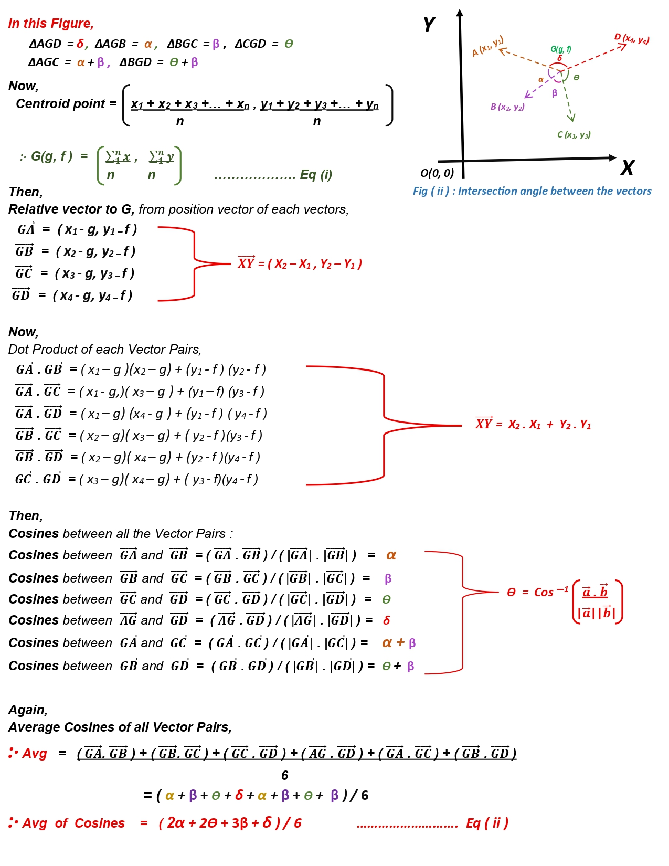
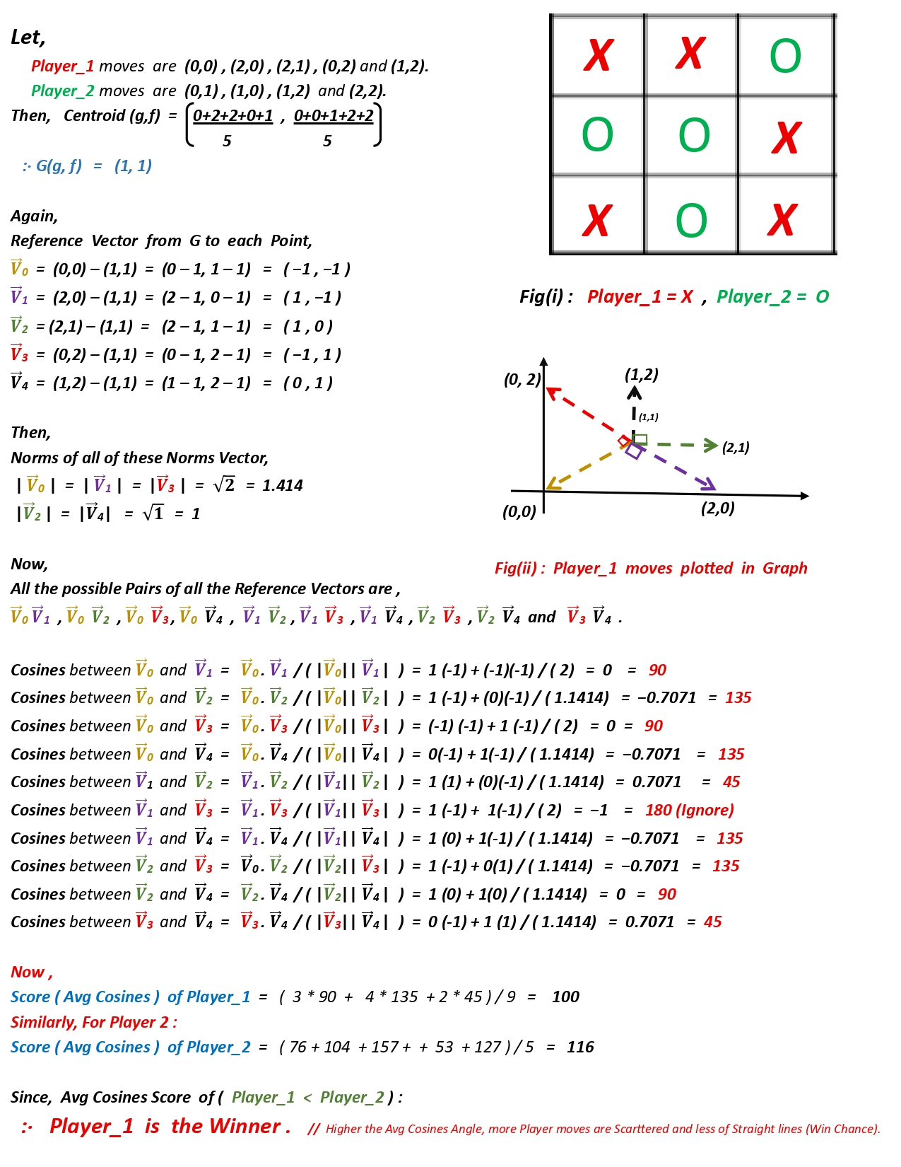
Theoretical Math :
Numerical Math :

Slide 12
What I did Best :
• Proper usages of academical concepts like Vectors, Co-ordinate Geometry .
• User desired (Scalable) grid size of Game from 3 * 3 to till N * N .
• Generates all possible Winning Conditions automatically instead of generating Manually ( Hard Coding ).
• With “ Tie – Break mode ” for mathematically deciding the winner , even when the games became ties .
• Structured programming Codes using Object ―Oriented Programming (OOP) .
Future Improvements :
• Integration with a full Graphical UI / UX for improved visual interaction .
• Integration of a automated player ( like AI ) to enable a single – user mode .
• More precise mathematical analysis through Linear Regression .

Slide 13
Thanks for watching…..
Your Sincere Student
RAI SURAJ
ID : 20244098

